Slide 1
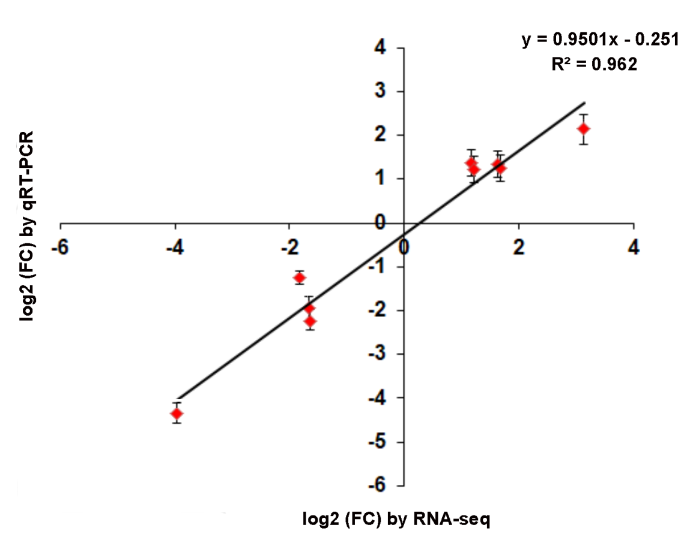
Fig. S2 Comparison of the log2 (FC) of 9 selected genes using qRT-PCR analysis. Both the log2 transformed values of relative expression of qRT-PCR and fold changes of RNA-seq data were used for linear regression. The Pearson’s correlation coefficient was used to measure the linear correlation of qRT-PCR and RNA-seq analysis.

